Slide 1
Ecommerce Data Analysis
Daniele Banni

Slide 2
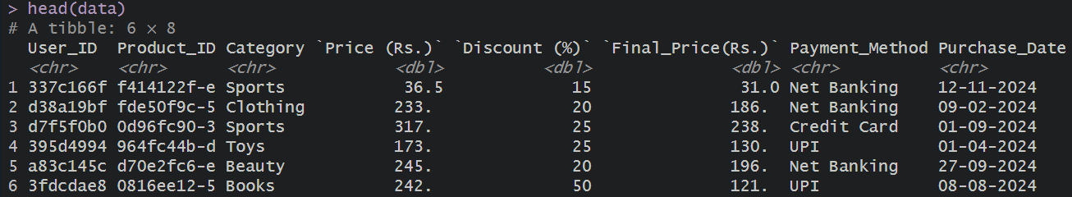
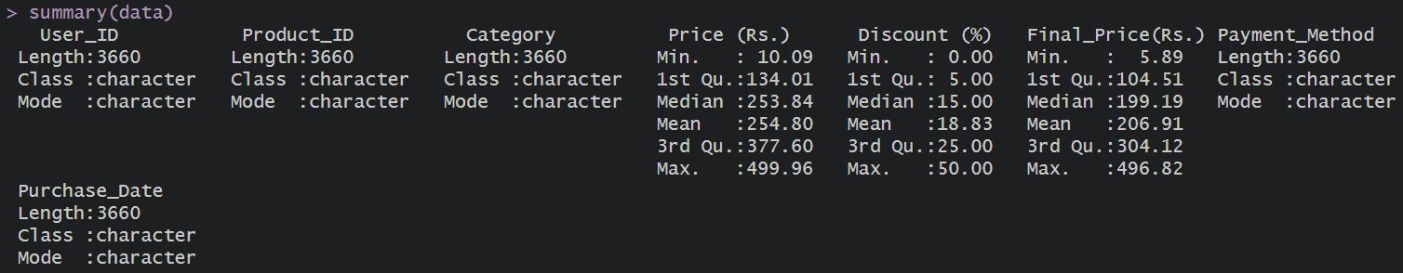
Descriptive analysis

Slide 3

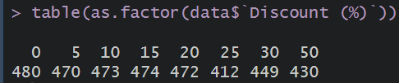
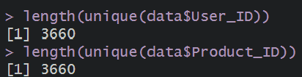

Slide 4

Cash on delivery: the customer pays at the delivery:
Credit card: the custom pays through his credit card;
Debid card: the customer pays through his debit card;
Net banking: also known as Internet Banking, allows you to perform various banking activities online.
UPI: Unified Payment Interface, is a real-time payment system developed by the National Payments Corporation of India (NPCI).

Slide 5
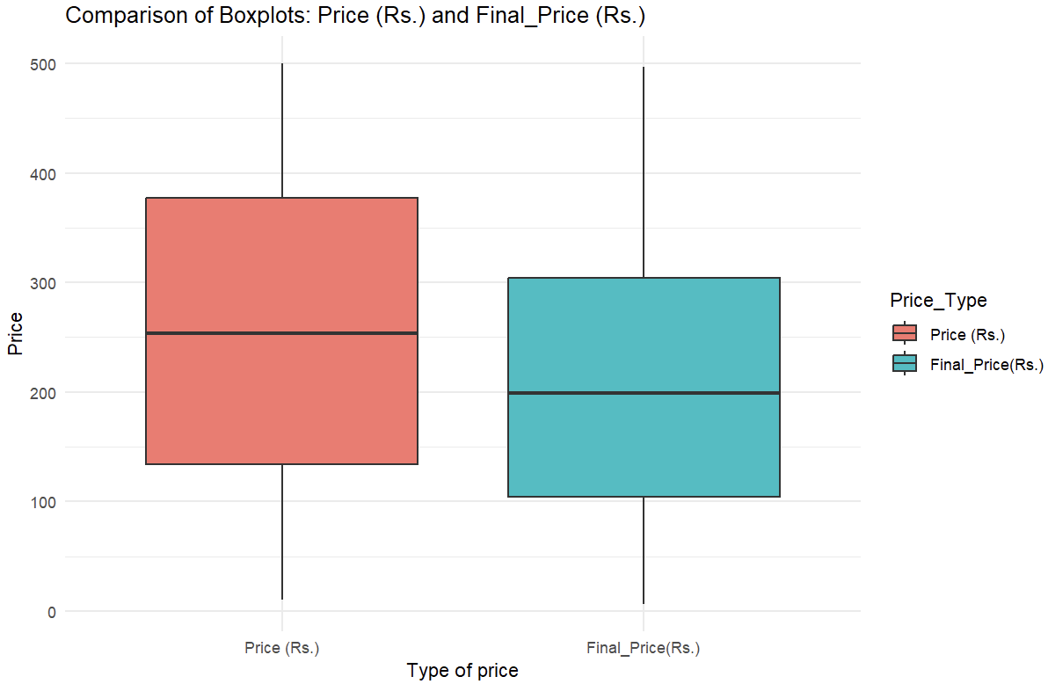
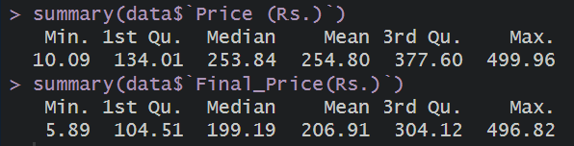

Slide 6
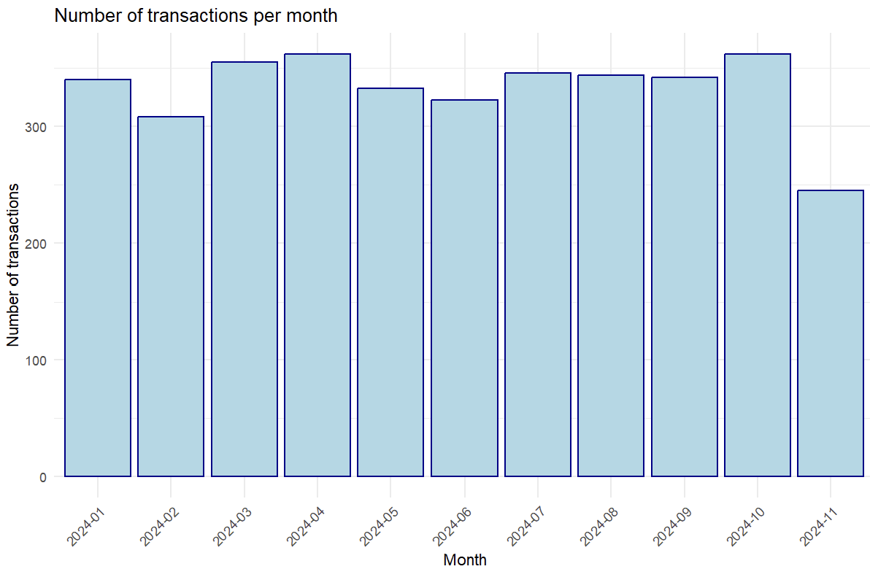
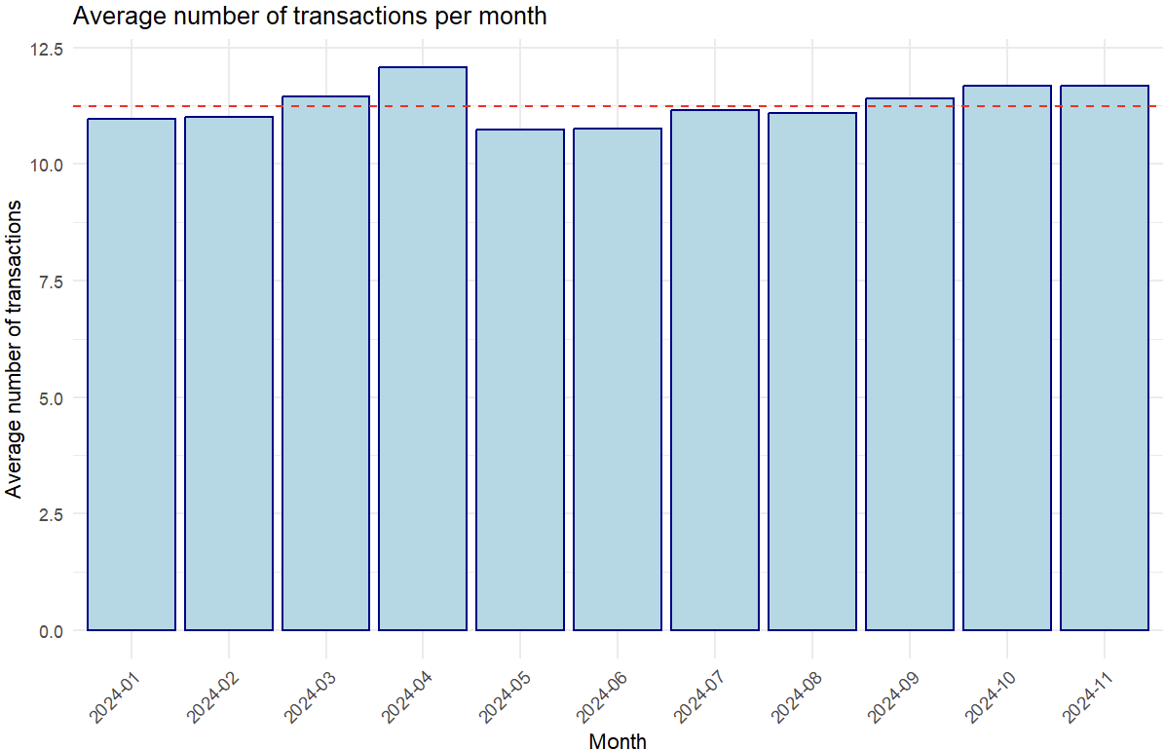
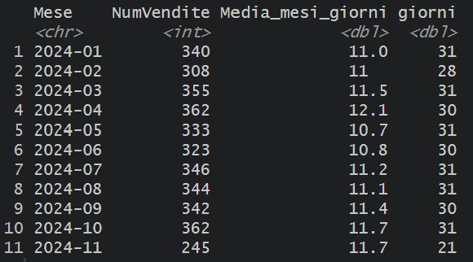

Slide 7
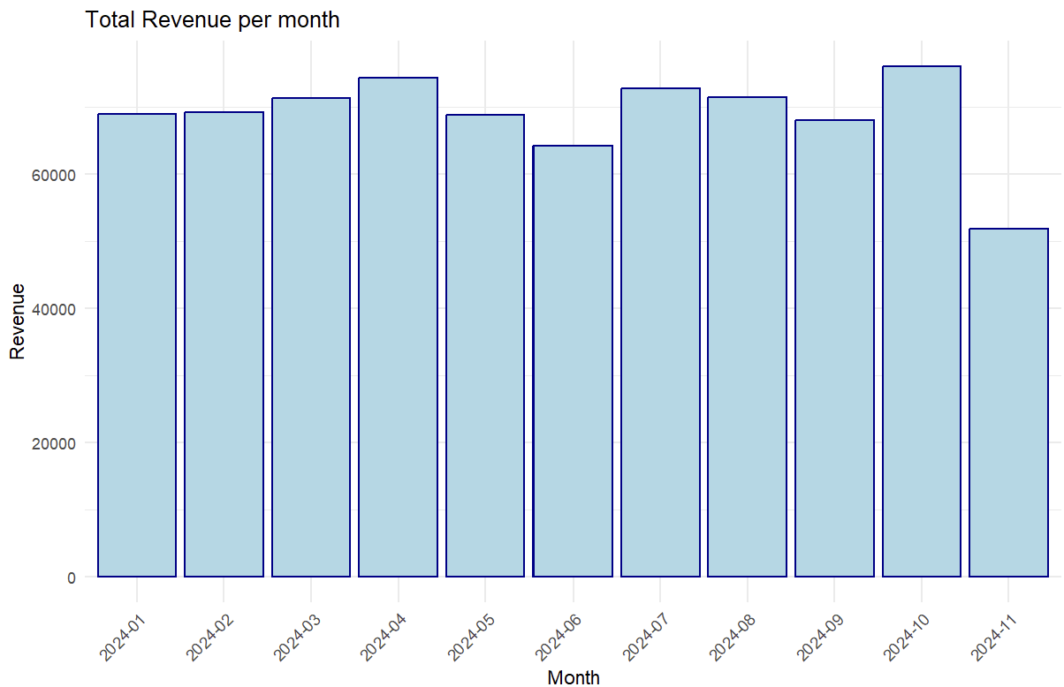
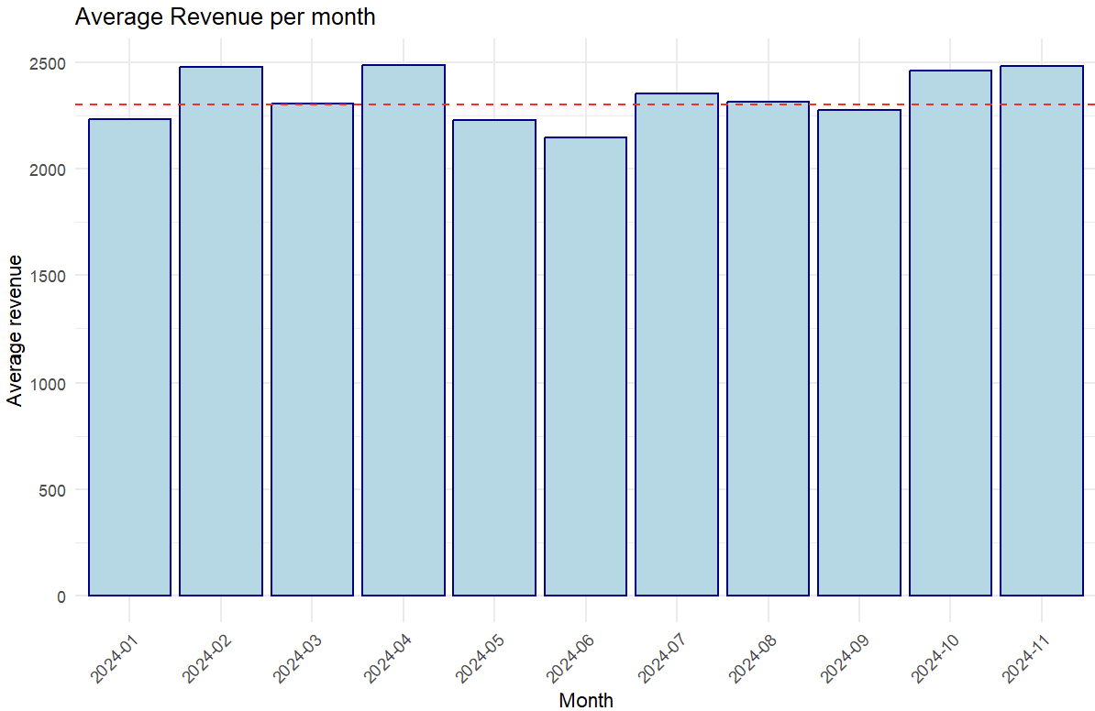
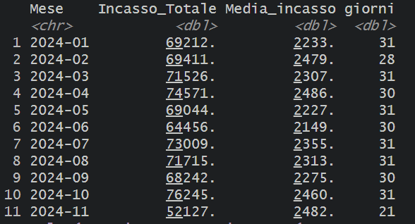

Slide 8
Revenues and months
Average revenues:
February, April, July, October and November present average revenues over the mean;
April is the month with the highest average revenue;
June is the month with the lowest value.
Average number of sales:
March, April, September, October and November present average number of sales above the mean;
April is the month with the highest number of transactions;
May and June are the month with the lowest values.

Slide 9
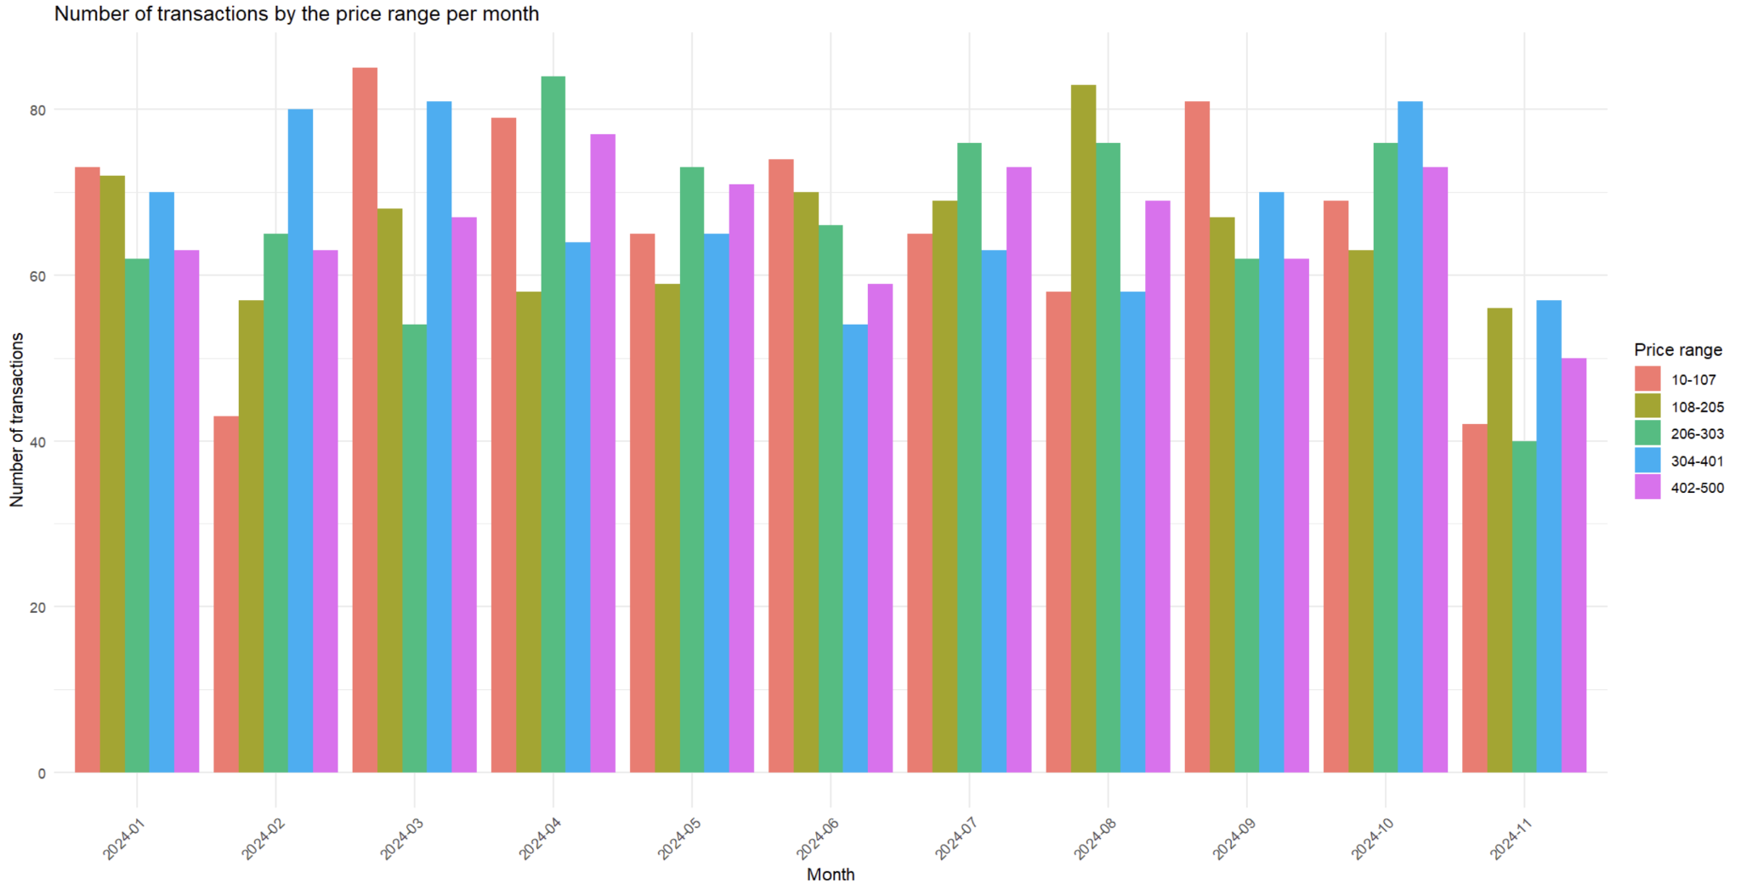
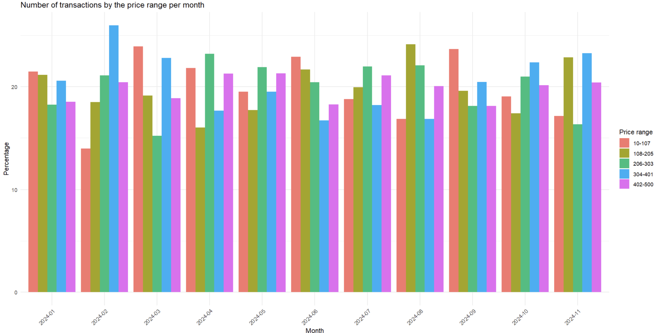
Price ranges and months
Frequencies:
March is the month with the highest value for “10-107” sales;
January, May and July present similar values for all the price ranges;
February, October and November show the highest values for the price range “304-401” ;
April presents the highest number of “402-500” transactions.
Percentages:
January, May, June, July, September and October do not present percentages clearly different;
February has the widest difference between 2 price ranges (“304-401” with 27% and “10-107” with 14%).

Slide 10
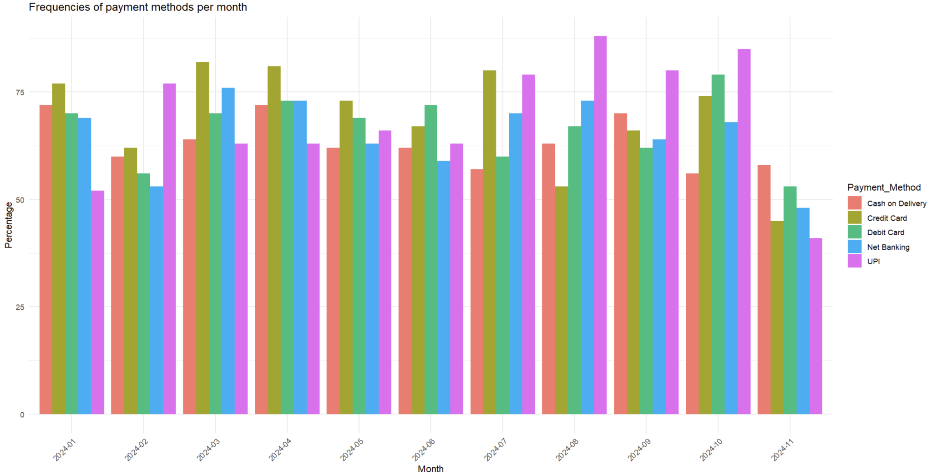
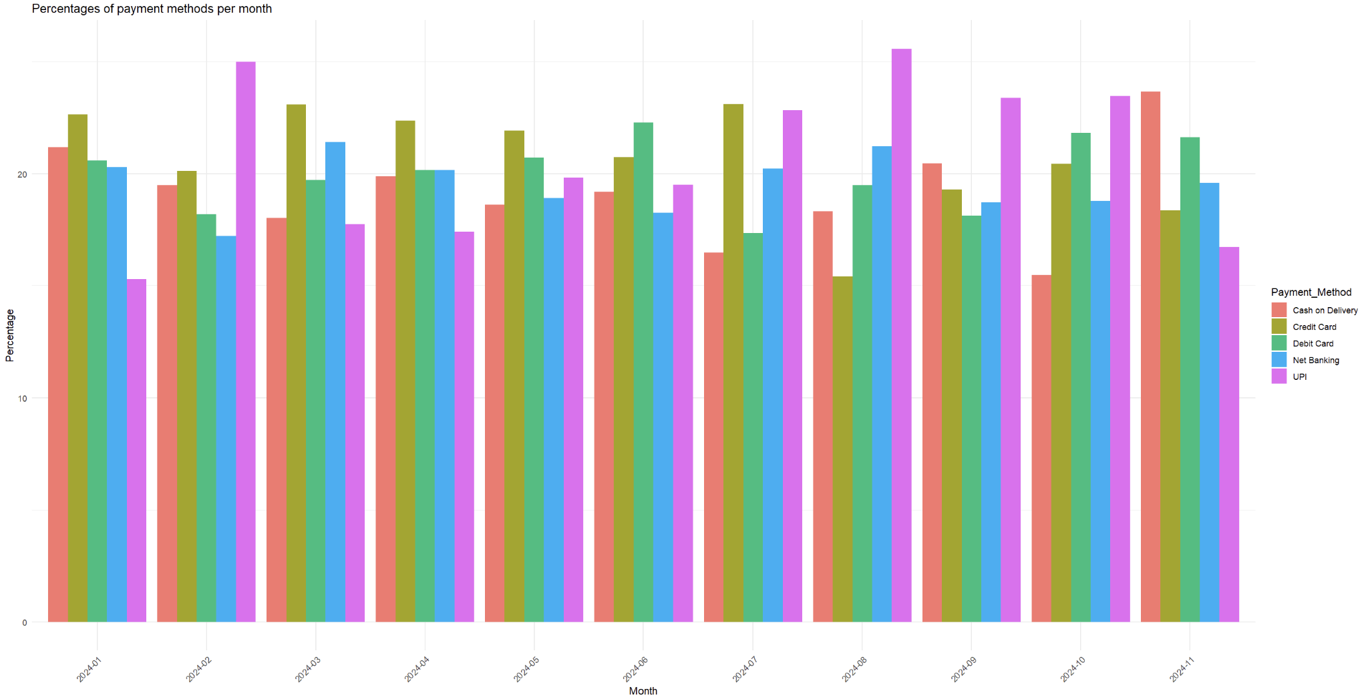
Payment methods and months
Frequencies:
February, August, September and October show the highest frequencies for the UPI, comparing the other payment methods;
May and June do not have any preferences for a specific payment method.
Percentages:
October is the only month where the method “Cash on Delivery” is the most used;
January, March, April, May and July present the highest percentages for the payment method “Credit Card”.

Slide 11
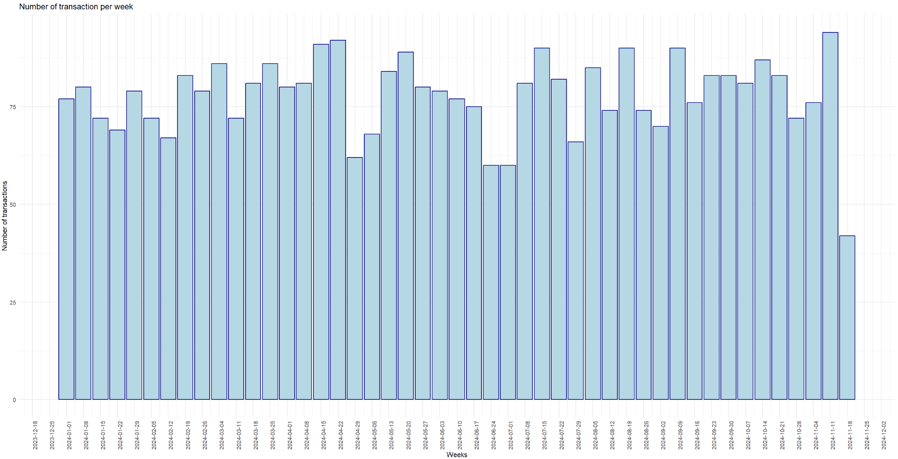
Sales per week

Slide 12
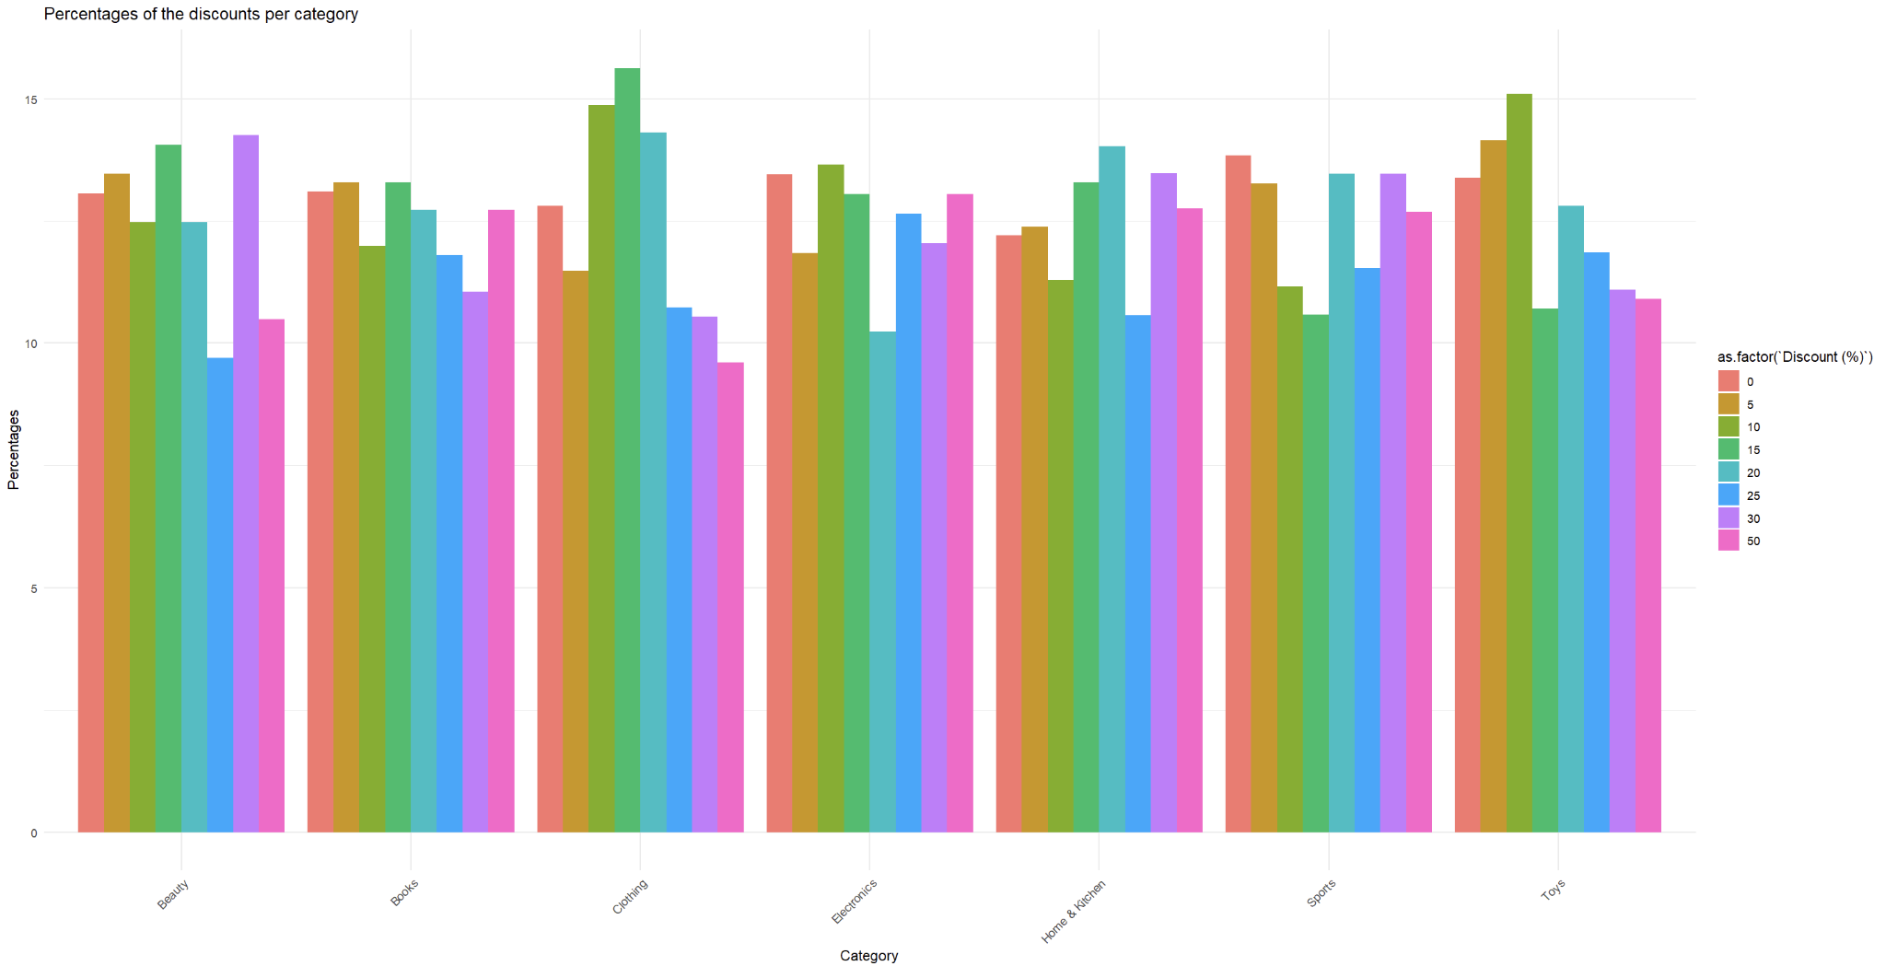
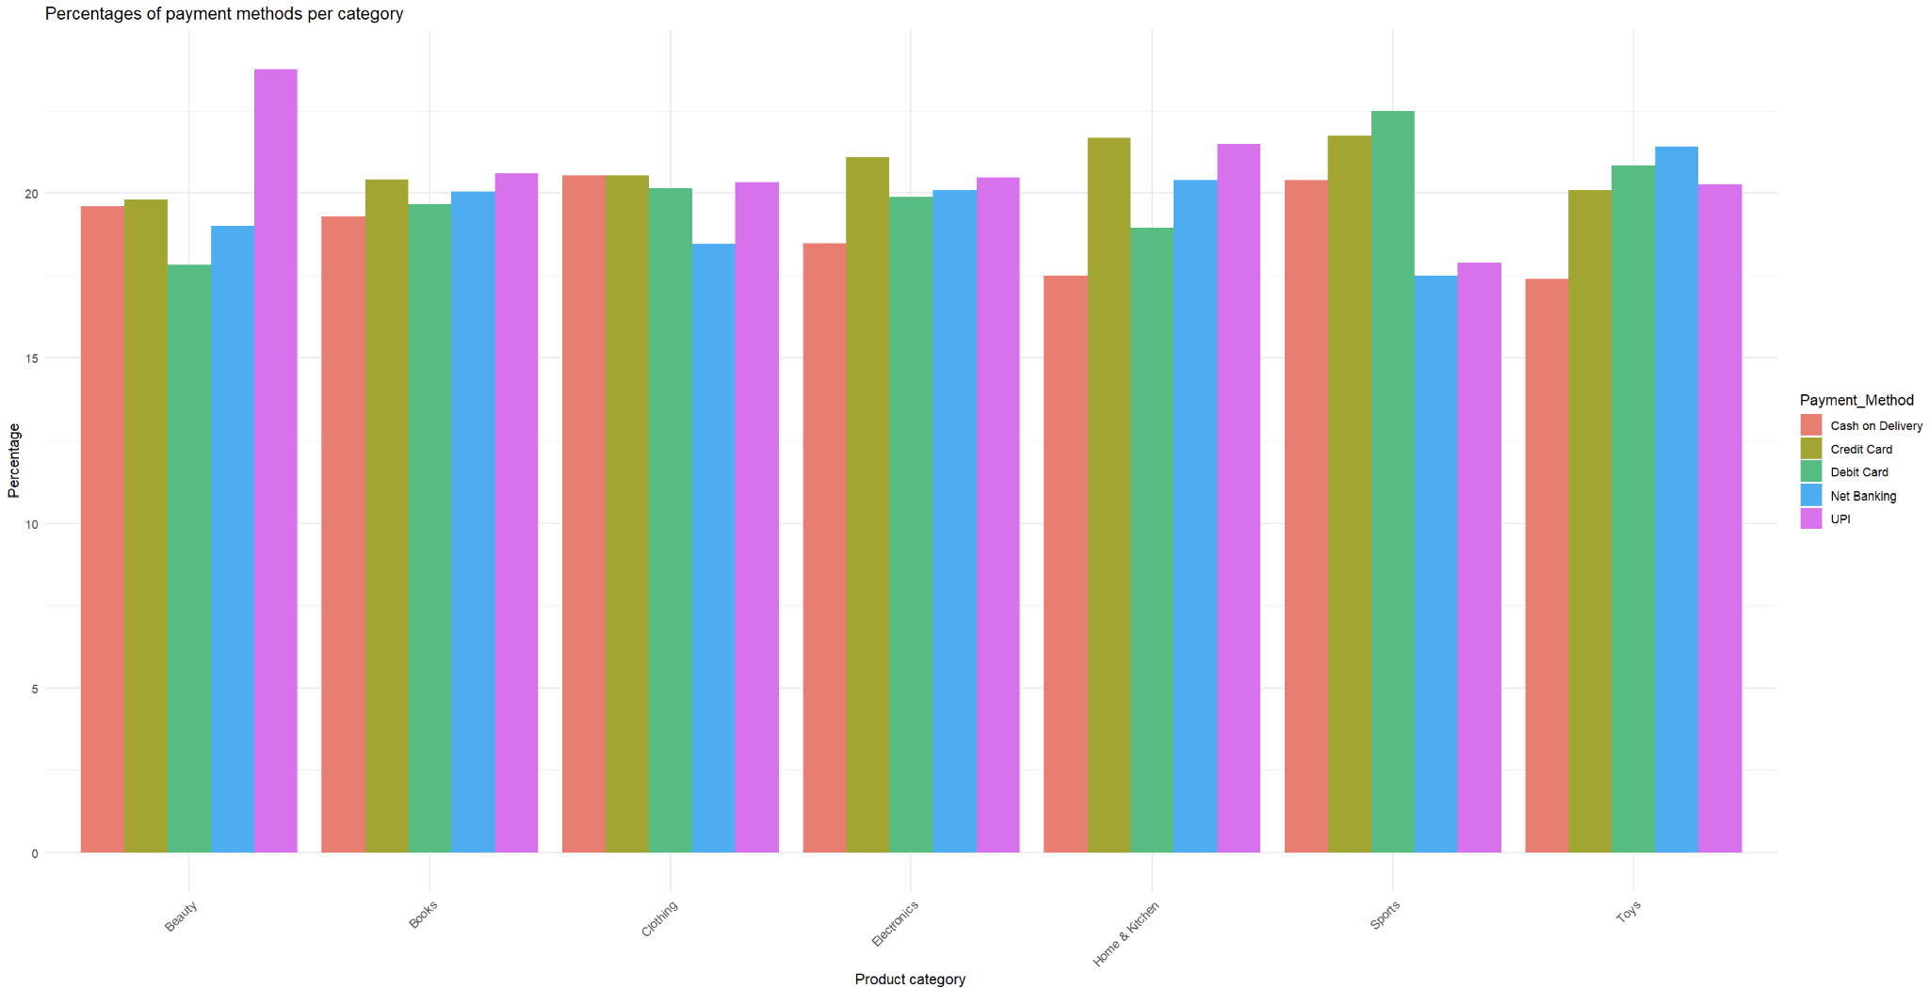
Categories compared by payment method and Discount
Discount:
Books, Electronics, Home & Kitchen do not present significant differences between the percentages of the discounts;
Clothing shows higher percentages between “10%” and “20%” of discount;
Home & Kitchen and Sports are the categories with the highest percentages of discount above 30%.
Payment Method:
There are no differences between the categories about preferences on the payment method;
Beauty is the only category which presents some difference between UPI and all the other methods.

Slide 13
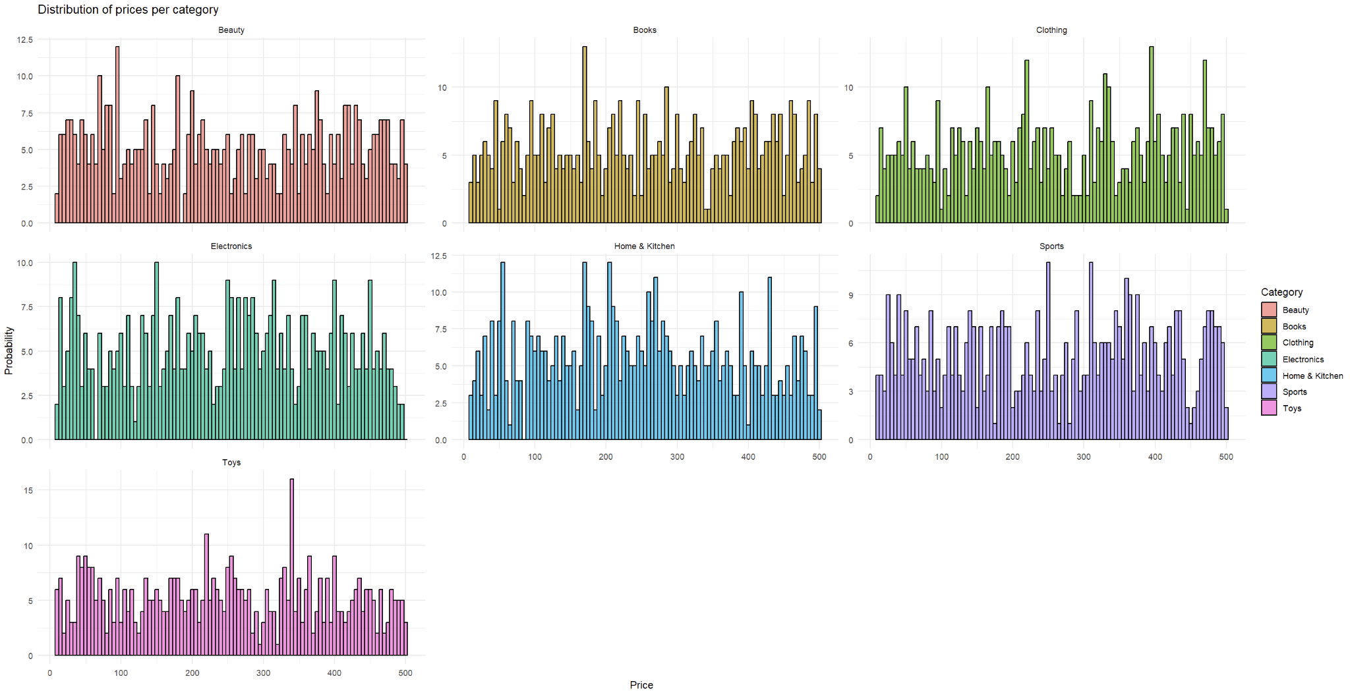

Slide 14
Linear Regression

Slide 15
Preparation of the dataset
Giorno_anno: each day in the dataset; Somma_Final_Price: sum of the “Final_Price(Rs.)” for each day;
Nvendite: sum of the sales for each day;
Nome_del_giorno: name of the day;
Nome_del_mese: name of the month;
Is_lunedi/martedi/..: one-hot encoding of the variable “Nome_del_giorno”;
Is_gennario/febbraio/..: one-hot encoding of the variable “Nome_del_mese”;
Beauty/Clothing/…: frequencies of item sold by category;
Beautyp/Clothingp/..: percentages of items sold by category.

Slide 16
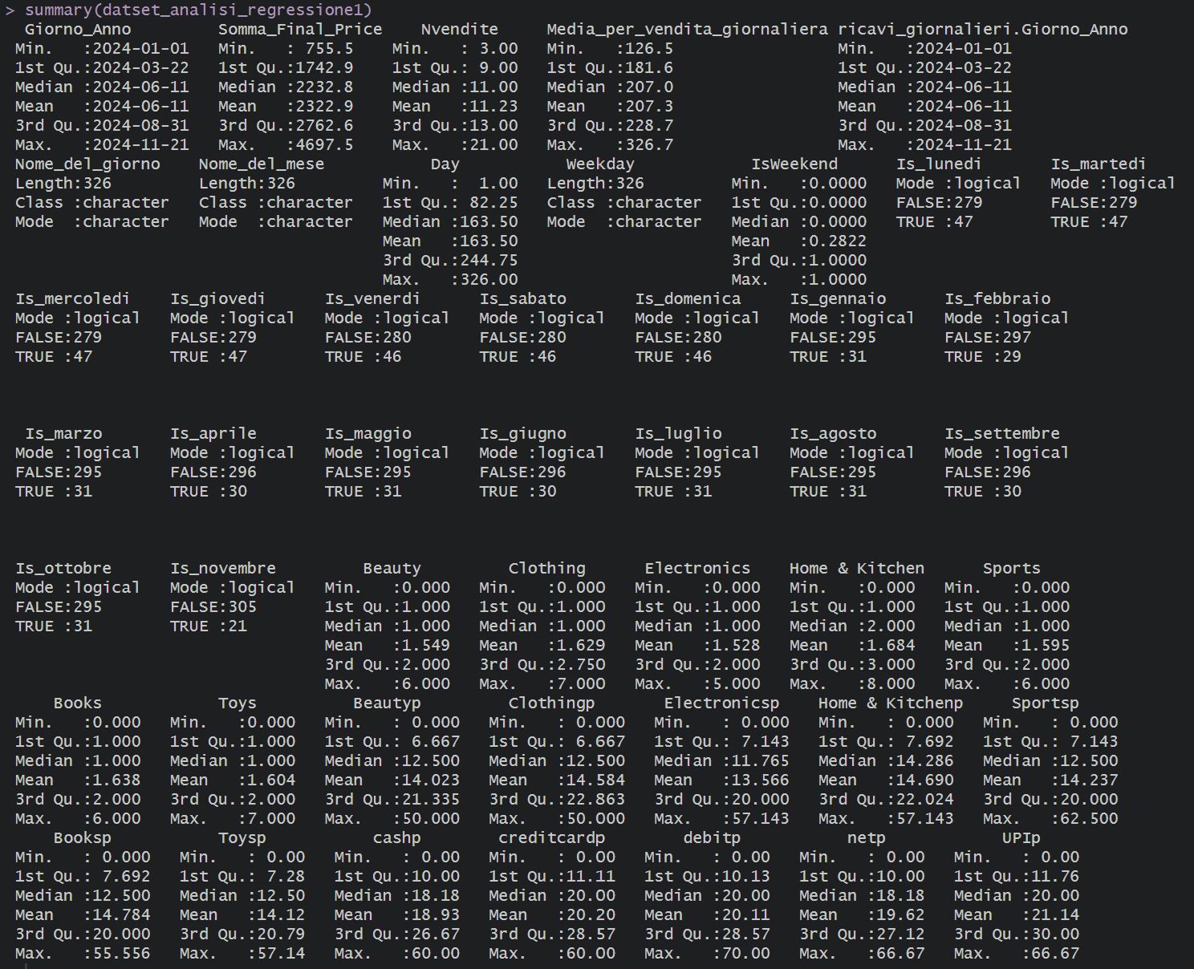

Slide 17
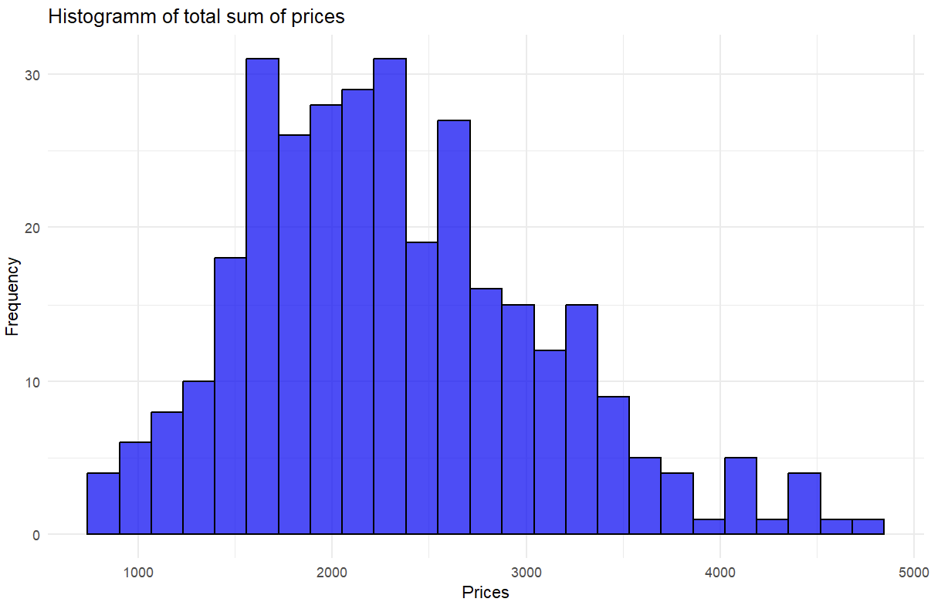
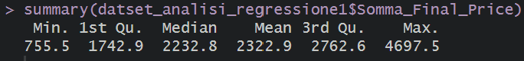
Somma_Final_Price as target variable

Slide 18
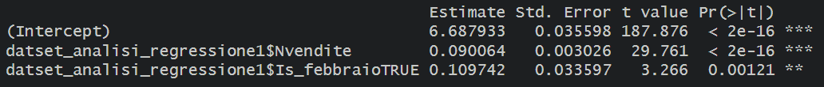
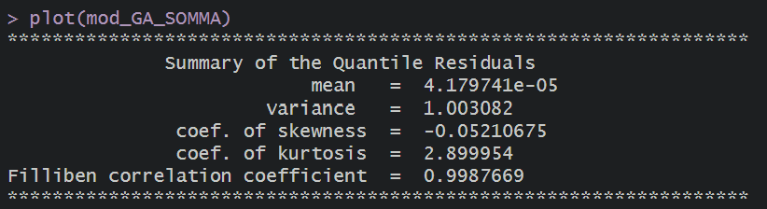
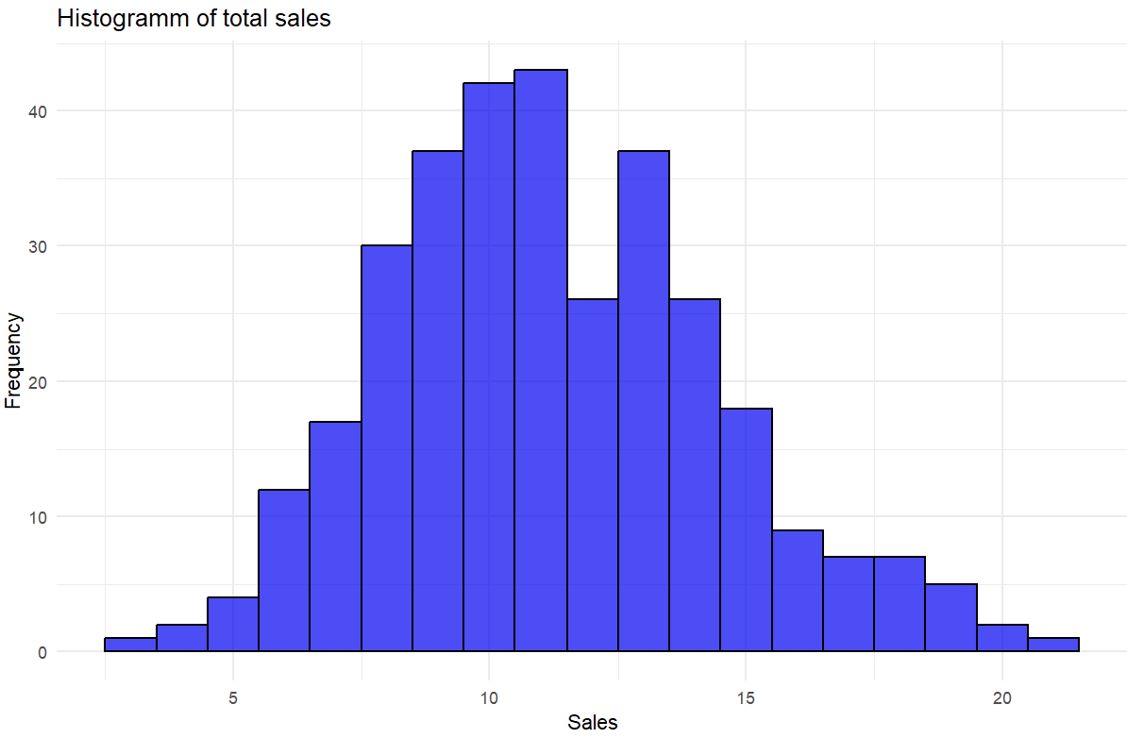
Linear regressione with Family GA
intercept = 802.66
nvendite = 9.43%
Is_febbraioTRUE = 11.59%

Slide 19
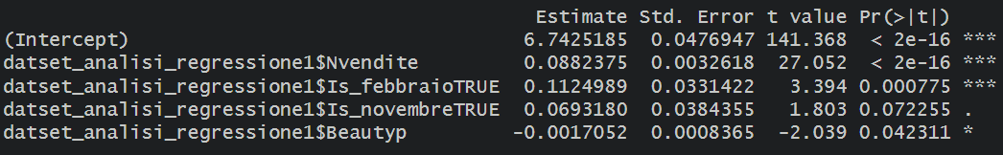
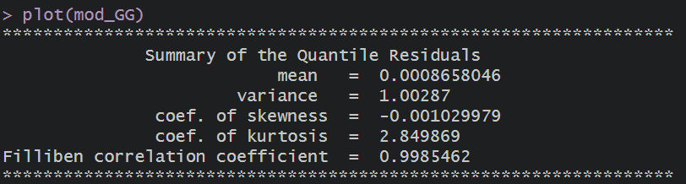
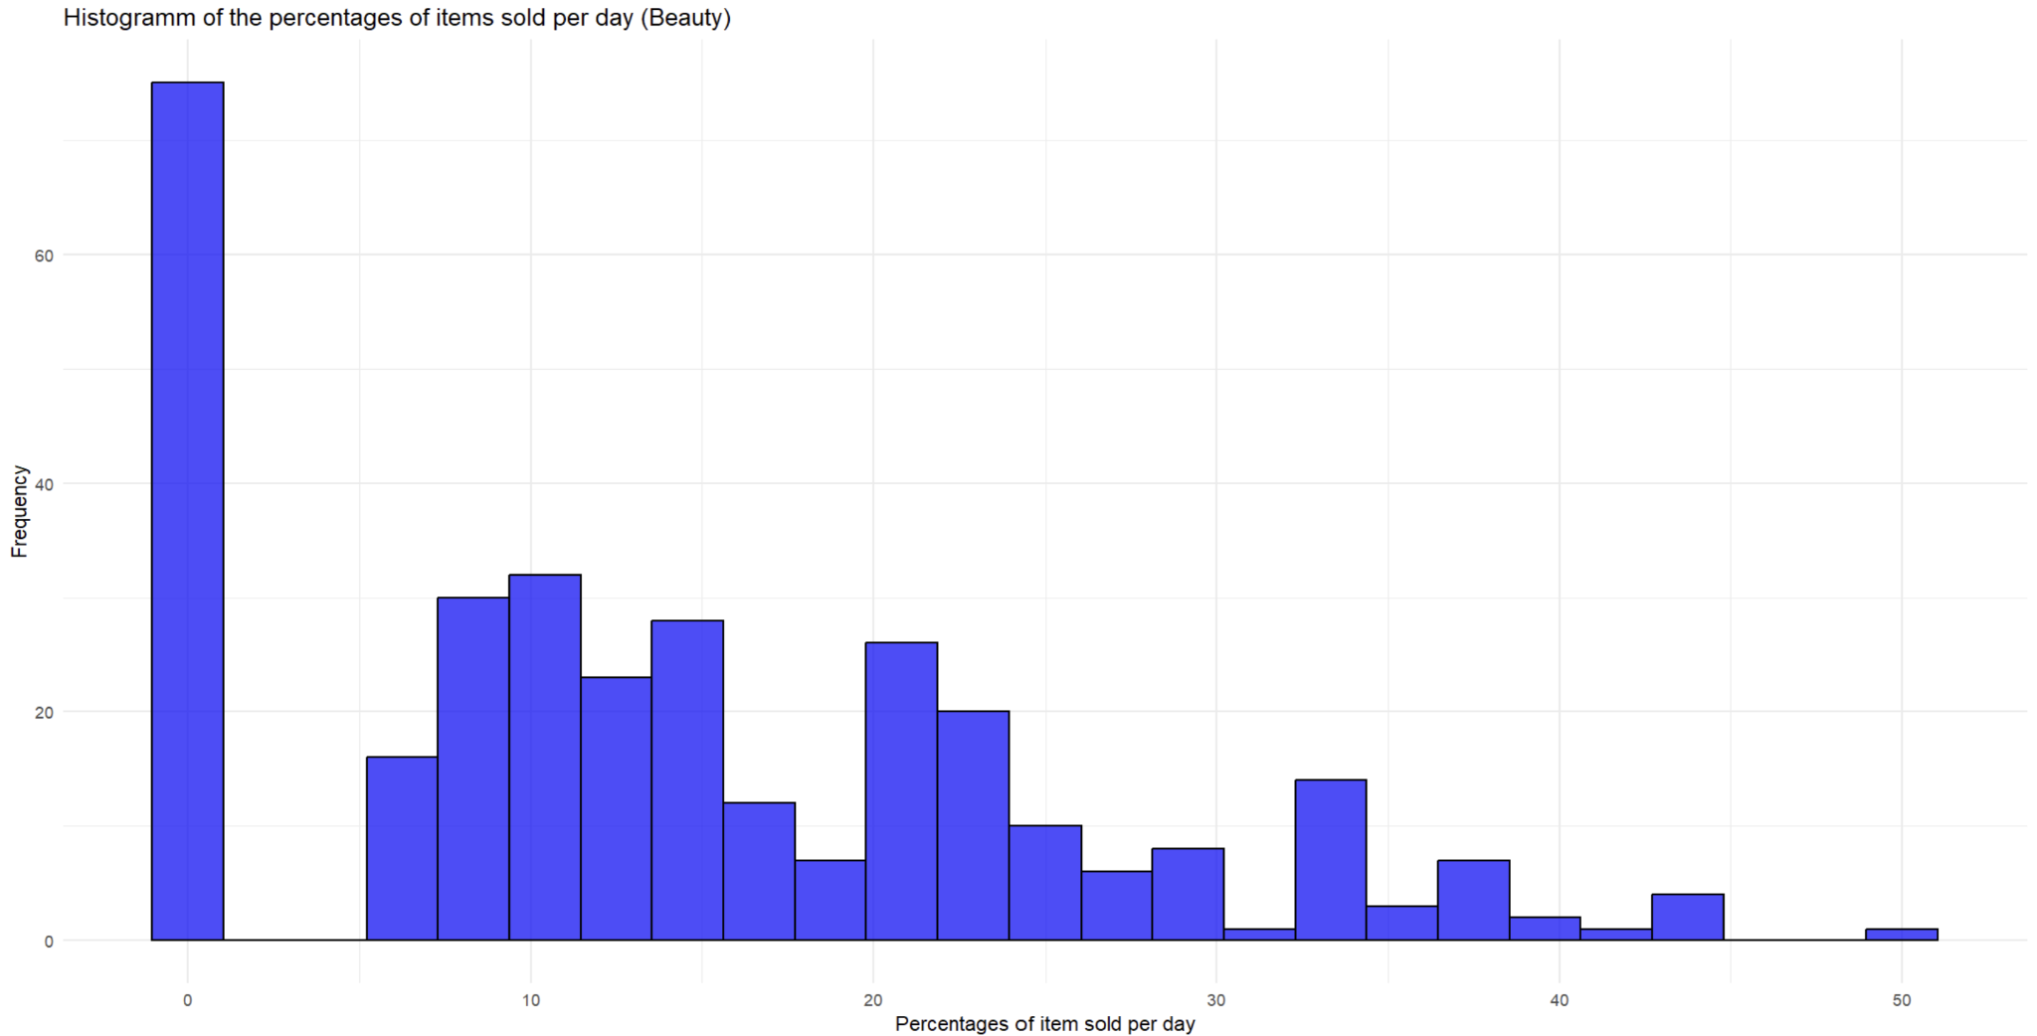
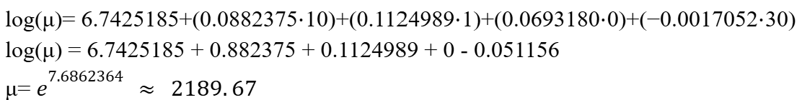
Linear regressione with Family GG
intercept = 847.69
nvendite = 9.2%
Is_febbraioTRUE = 11.9%
Is_novembreTRUE = 7.1%
Beautyp = -0.2%

Slide 20
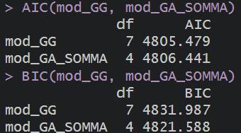
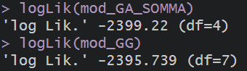
Linear regressione with Family GG and GA

Slide 21
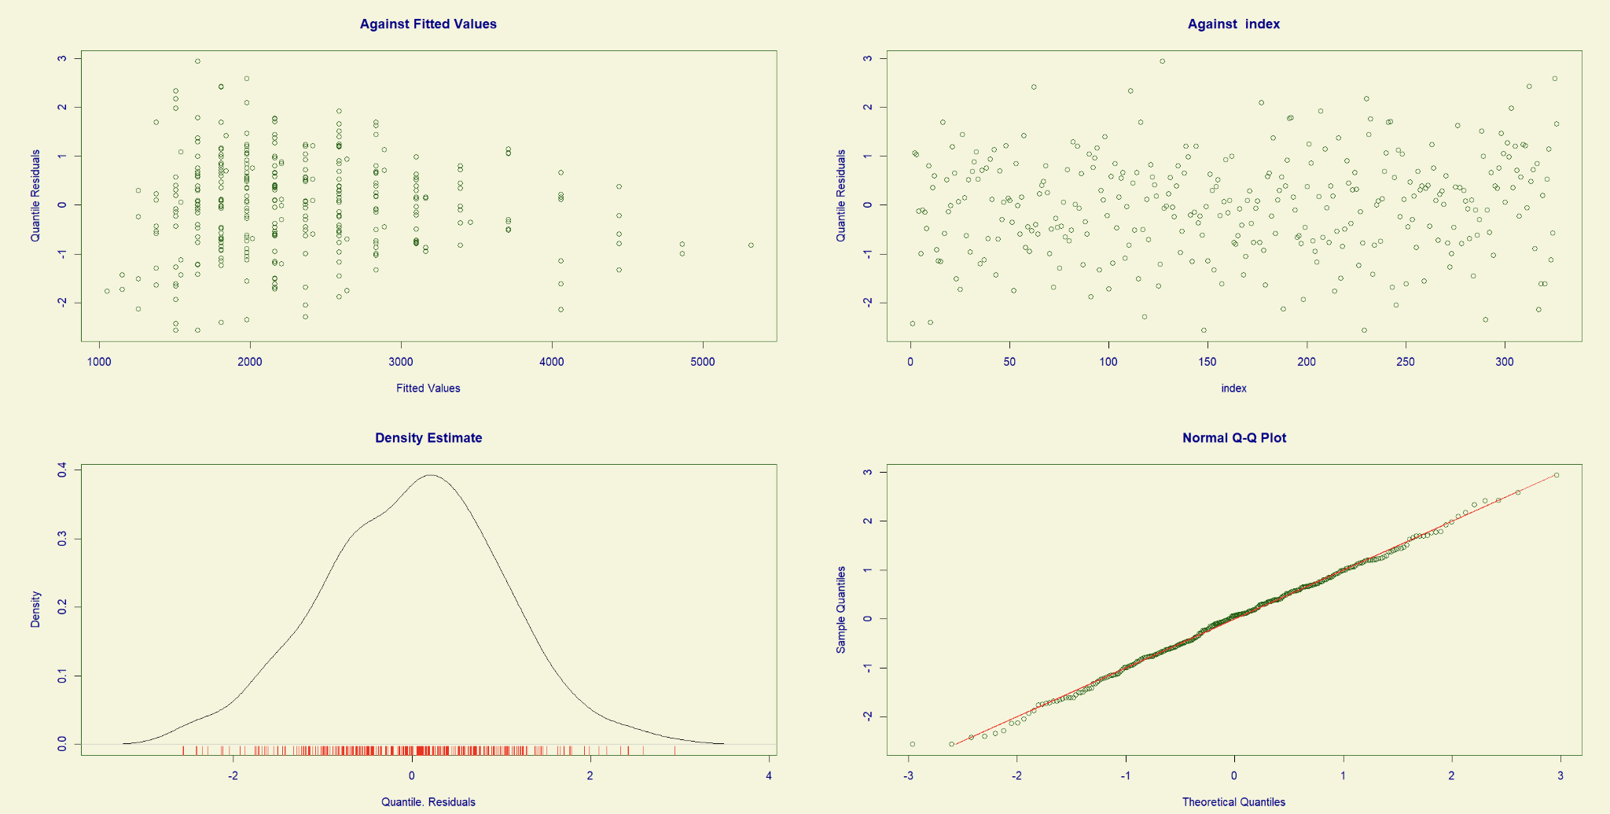

Slide 22
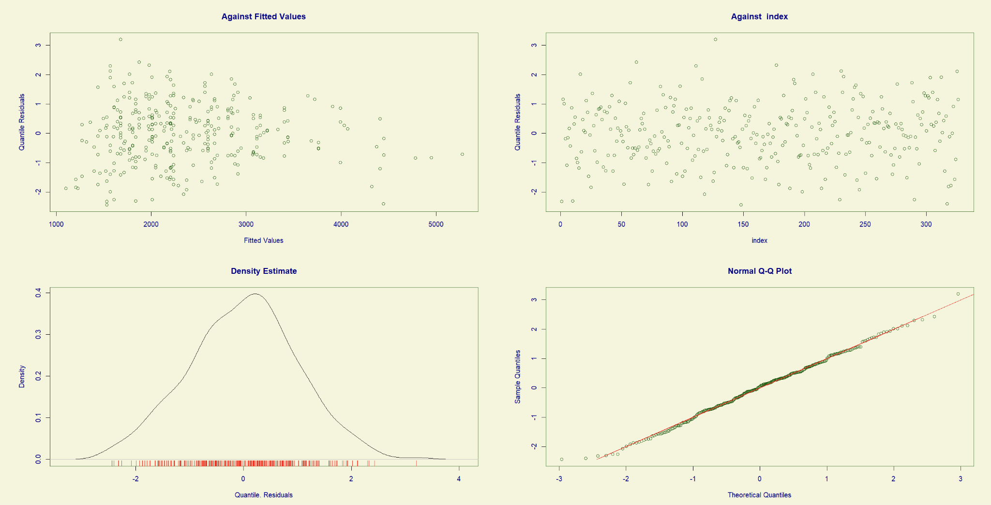

Slide 23
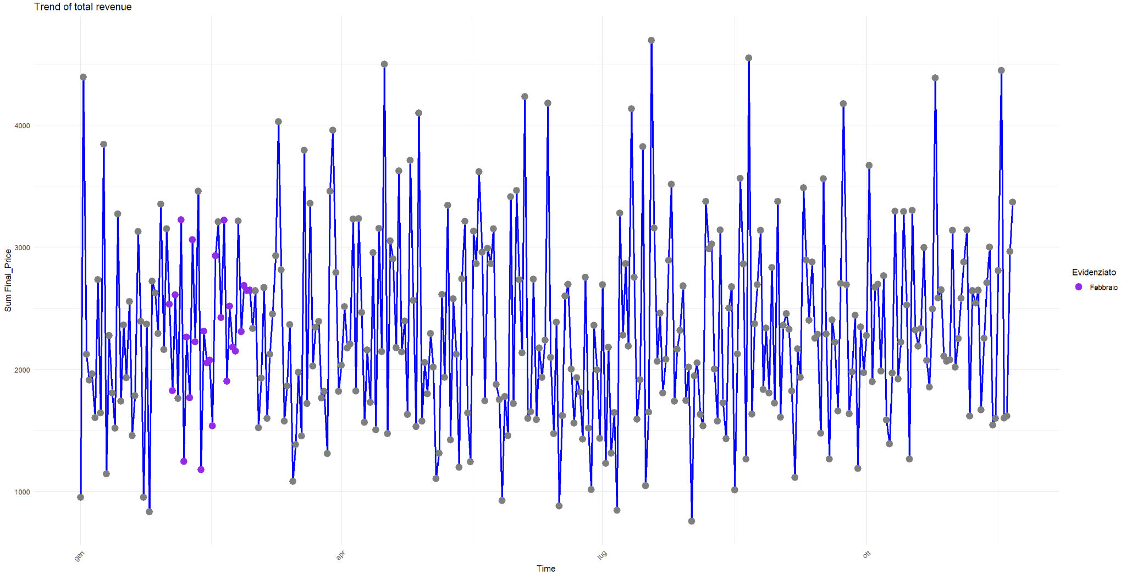

Slide 24
Cluster analysis

Slide 25
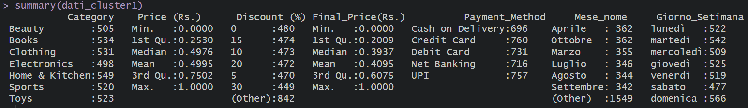
Preparation of the dataset for using “Gower” distance
Category: transformed as factor;
Price (Rs.) and Final_Price(Rs.): standardized in the range 0-1;
Discount: transformed as factor;
Payment method: transformed as factor;
Mese_nome: trasformed as factor;
Giorno_Settimana: trasformed as factor.

Slide 26
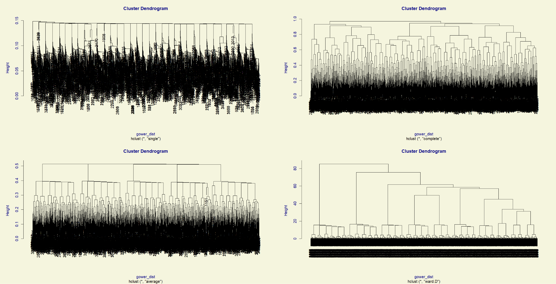

Slide 27
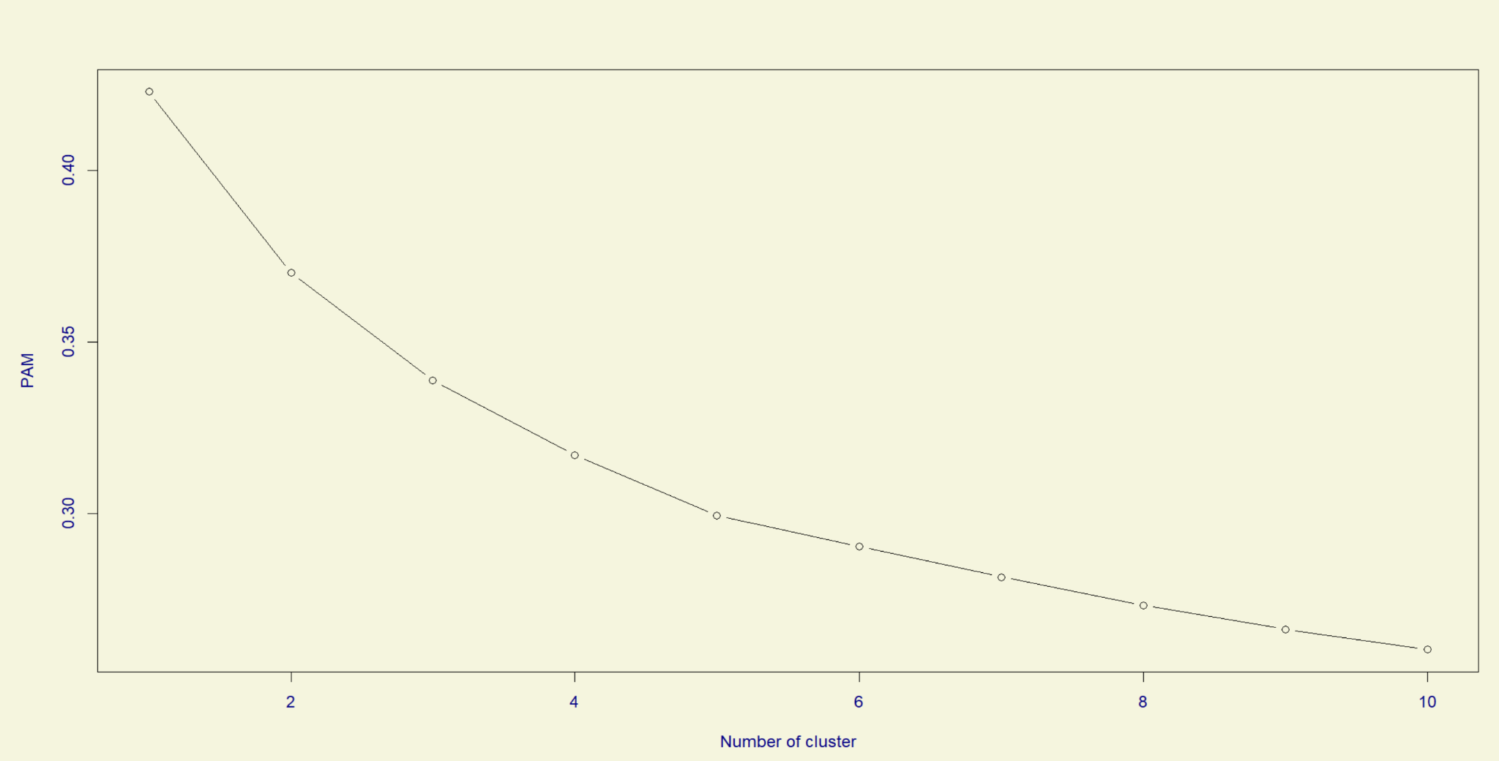
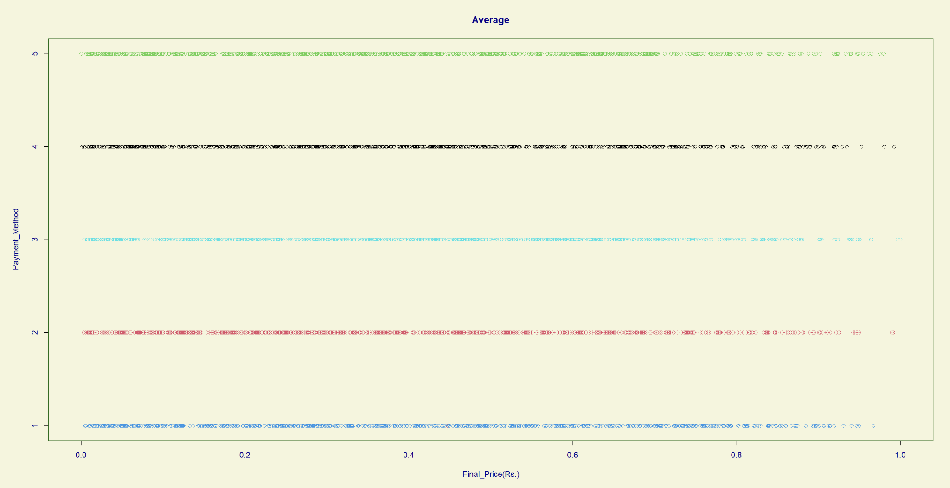
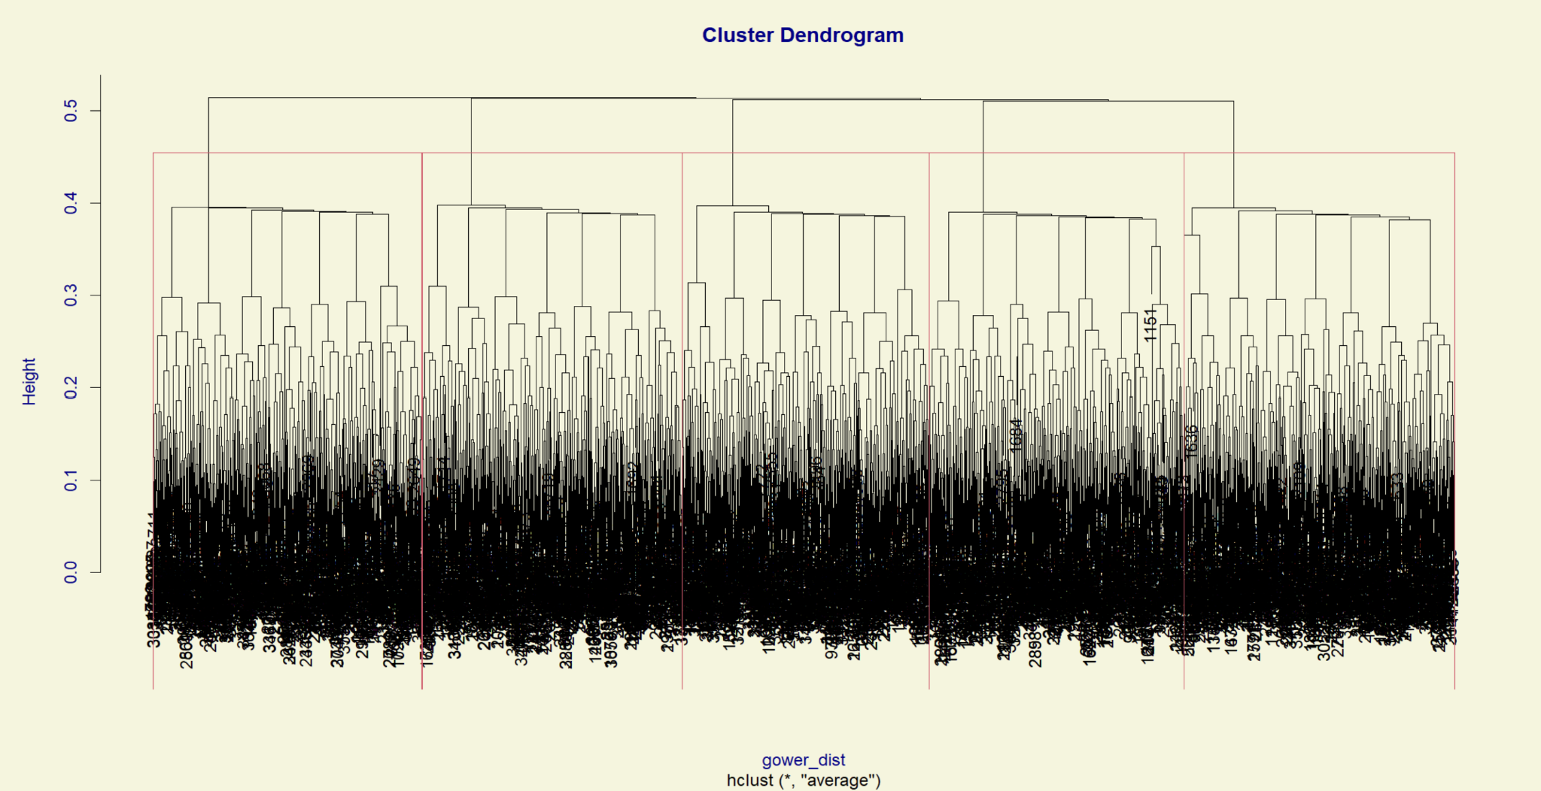

Slide 28
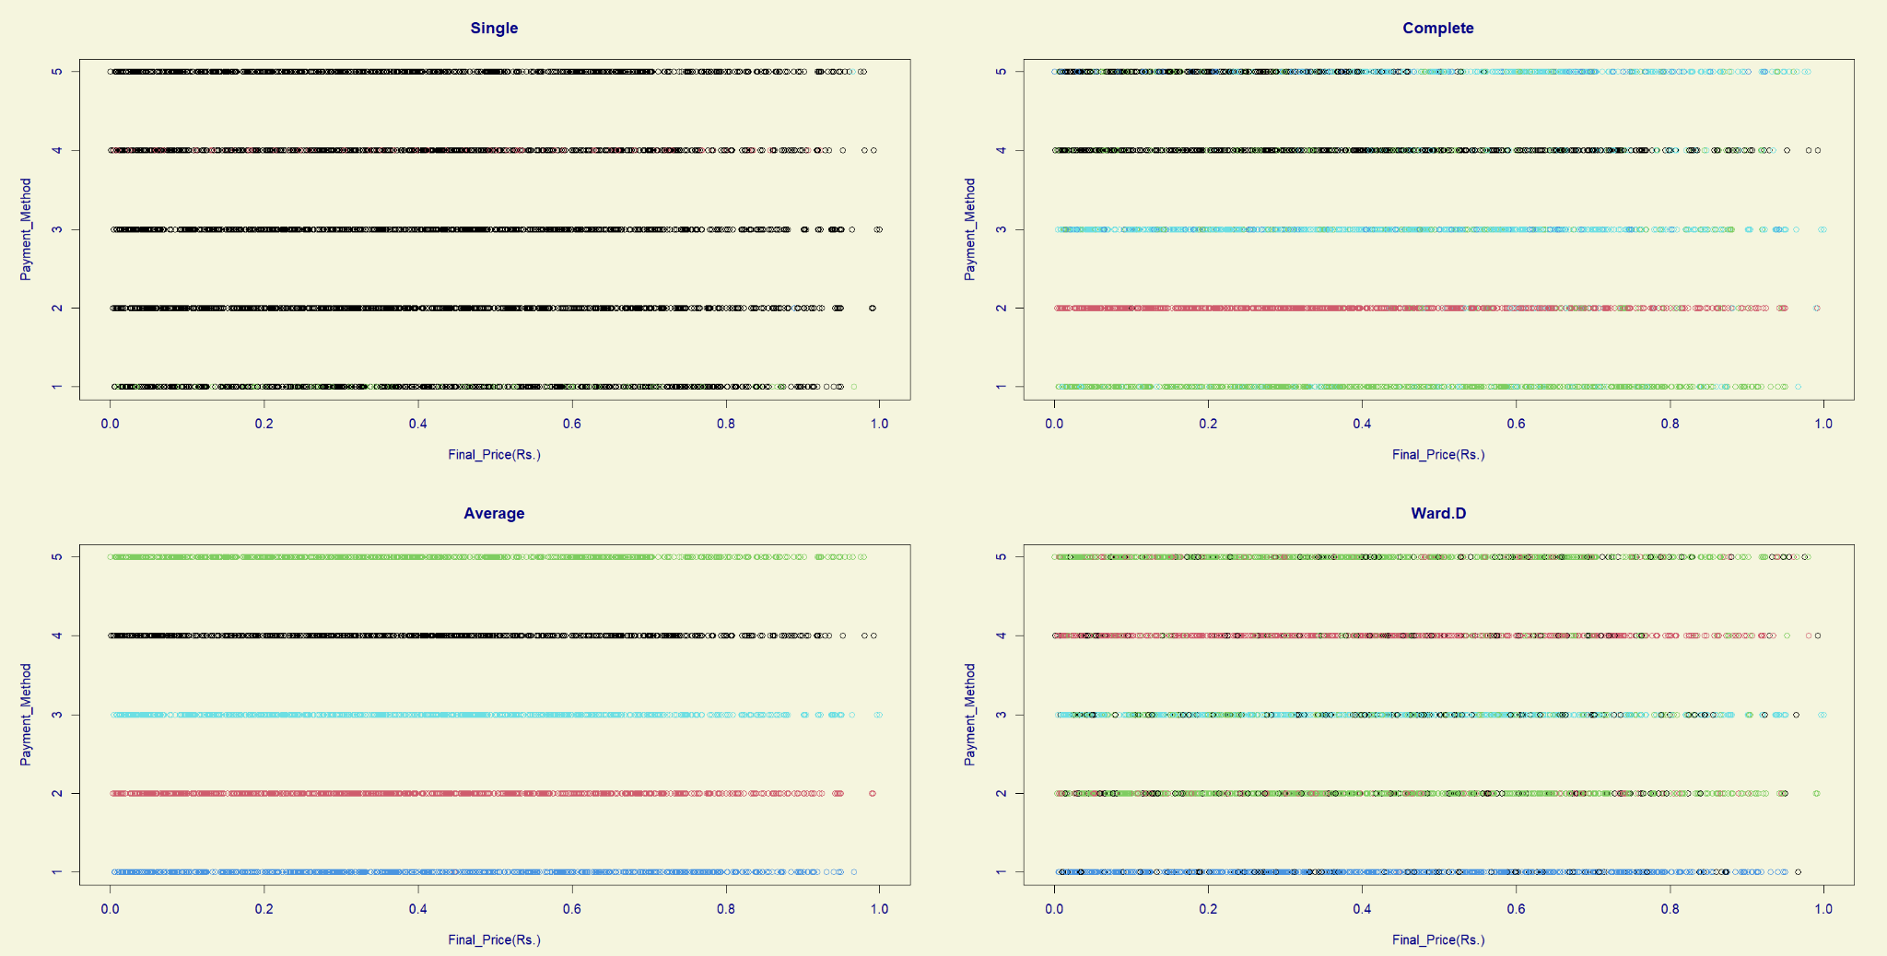

Slide 29
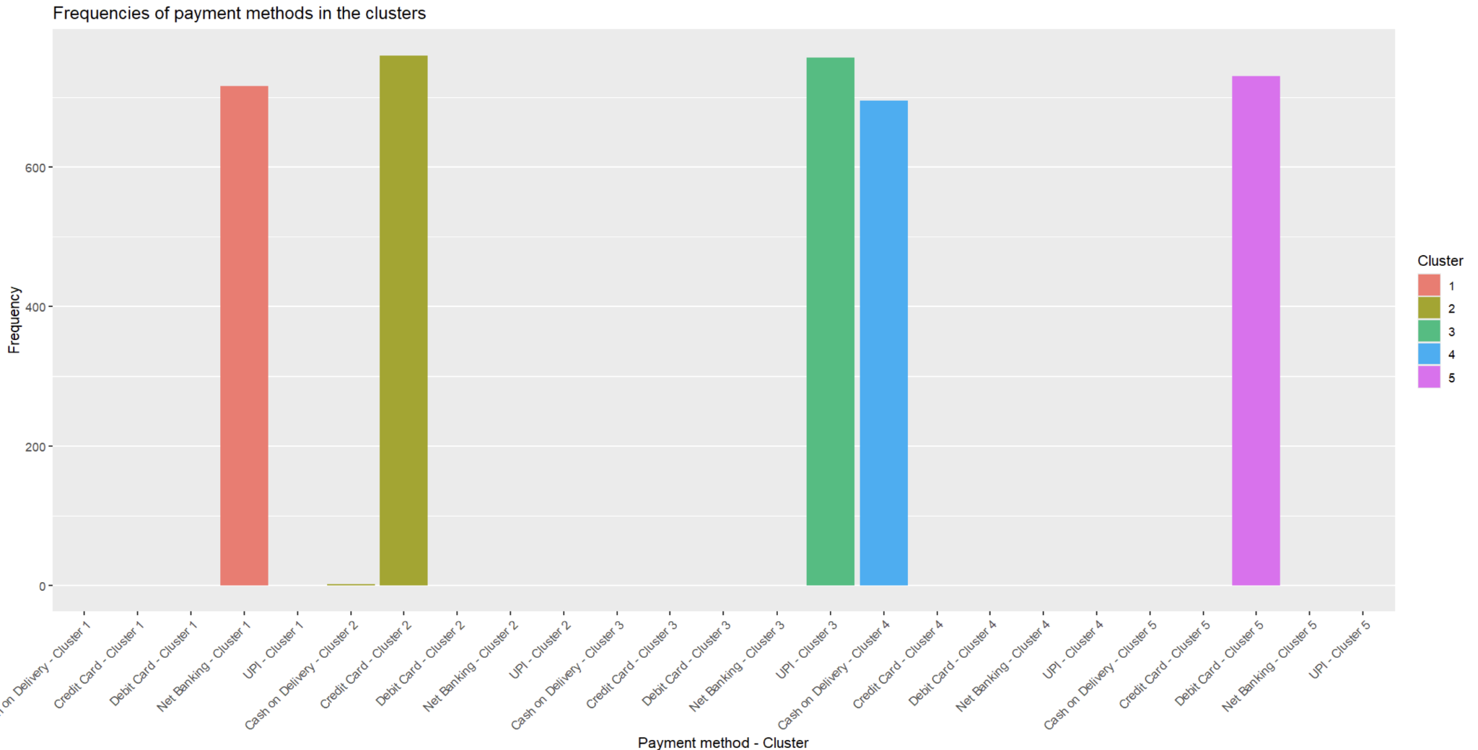
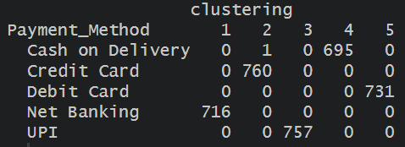

Slide 30
Thank you for the attention!

